Slide 1
Smart Scrum Doc – Automated Scrum Meeting Documentation System
Dr.M.V.N Srujan Manohar Computer Science & Engineering Dept. of Cyber Security & IoT Malla Reddy University Hyderabad, India srujanmanohar.edu@gmail.com
Devansh Mishra
Computer Science & Engineering Dept. of IoT
Malla Reddy University
Hyderabad, India 2211cs050023@mallareddyuniversity.a c.in
Geetha Sirvi
Computer Science & Engineering Dept. of IoT
Malla Reddy University
Hyderabad, India 2211cs050029@mallareddyuniversity.a c.in
Sahithi Mandham
Computer Science & Engineering Dept. of IoT
Malla Reddy University
Hyderabad, India 2211cs050062@mallareddyuniversity.a c.in
Abstract— Effective documentation and analysis of meetings are important for accurately gathering requirements and keeping track of decisions in software development. However, traditional ways of documenting meetings depend mostly on manual note-taking, which is slow, error-prone, and doesn’t provide deep insights. This paper introduces an AI-powered meeting intelligence system that automatically captures, transcribes, and analyzes group discussions during meetings in real time. The system records audio from multiple people, identifies who is speaking through speaker diarization, and uses automatic speech recognition to create transcripts that include time stamps and speaker labels. Additionally, natural language processing techniques are used to pull out key discussion points, detect product backlog items mentioned by clients, and create brief summaries of the meetings.The results show that this approach improves the accuracy of meeting records, reduces the need for manual work, and provides useful insights for agile software development environments. To tackle this issue, this study introduces SmartScrumDoc, a web-based tool that helps automatically document Scrum meetings. The system takes recorded meeting audio and converts it into text using speech recognition technology. After creating the transcript, natural language processing is used to analyze the conversation and find important details like key discussion points, tasks, and possible backlog items. The system also creates a short summary to give a quick overview of the discussion. The goal of this approach is to cut down on the manual work needed for documenting meetings while making the process clearer and more accountable for Scrum teams. Along with generating transcripts and summaries, the system also creates structured outputs like action points and product backlog items that can help with planning projects. By turning meeting discussions into organized records, SmartScrumDoc can assist development teams in keeping accurate records and enhancing teamwork in agile project settings.
Keywords— Meeting Intelligence, Automatic Speech Recognition, Speaker Diarization, Natural Language Processing, Meeting Summarization, Product Backlog Extraction, Agile Software Development.
and managing the development process [2]. Scrum promotes regular communication among team members through structured meetings like daily stand-ups, sprint planning sessions, sprint reviews, and retrospectives. These meetings help the team stay aligned on tasks, review the project's progress, spot any issues, and plan the next steps. Good communication during these meetings is key to staying productive and making sure that the project stays on track [3]. Even though Scrum meetings are important, many teams struggle with keeping accurate records of what's discussed. Key decisions, task assignments, and problem details are often shared verbally but not properly written down. In many cases, teams depend on handwritten notes or just relying on memory to capture meeting outcomes [4]. This method can be slow and usually leads to incomplete or incorrect records. Because of this, team members might forget important details, misinterpret requirements, or miss out on follow-up actions. New developments in artificial intelligence have opened up new possibilities for automating meeting documentation and analysis. Tools like Automatic Speech Recognition (ASR) can convert spoken words into text [5], and Natural Language Processing (NLP) allows computers to understand and analyze large amounts of text to extract useful information [6]. These technologies help turn meeting discussions into organized records that include summaries, action items, and other valuable details. In the context of agile development, an automated system capable of converting Scrum meeting discussions into organized documentation could significantly improve project management processes. Such systems can assist teams in capturing important information without requiring additional manual effort [7]. By identifying key statements and extracting actionable tasks from meeting transcripts, automated tools can generate useful artifacts such as meeting summaries and product backlog items [8]. This can enhance transparency, improve accountability among team members, and ensure that important decisions are properly recorded. To address these challenges, this research proposes SmartScrumDoc, an automated system designed to support the documentation and analysis of Scrum meetings. The system captures meeting audio and converts it into text using speech recognition techniques [9]. Natural language processing methods are then applied to analyze the transcript and extract important information such as summaries, action items, and product backlog entries. By providing structured and accessible documentation of Scrum meetings, the proposed system aims to reduce manual documentation effort while improving communication and collaboration within agile development teams [10].Recent studies on intelligent meeting analysis have shown that Natural Language Processing (NLP) techniques can automatically identify key
I.Introduction
Agile software development has become a popular way to handle modern software projects because it offers flexibility, adaptability, and a focus on teamwork [1]. Out of the various agile methods, Scrum is one of the most widely used frameworks for organizing

Slide 2
Recent studies on smart meeting analysis have found that Natural Language Processing (NLP) can automatically find the main topics in long meeting recordings [11]. These systems look at how sentences are built and what they mean to find important things like decisions, tasks, and actions that need to be followed up on. Because of this, tools that use AI for meeting notes can save a lot of time compared to writing notes by hand, while still keeping all the key points from the discussion. Another important part of automated meeting documentation is speaker diarization. This helps identify and separate different people speaking in a conversation. According to research in [12], these algorithms look at the sound of speech to figure out when each person is talking. This makes meeting transcripts more clear by linking each statement to the right speaker, which helps with responsibility and makes the notes more useful in teamwork settings like Scrum teams. In agile project management, Scrum meetings often include useful information about future tasks and needs. Research mentioned in [13] shows that advanced NLP models can look through meeting talks and find statements that relate to requirements. By pulling out these statements and turning them into structured tasks, automated systems can help create product backlog items, which are important for managing work in Scrum-based software projects.
recording. The review in [9] explains that these algorithms analyze the sound of speech to determine when different people are talking. This helps create clearer transcripts by linking each statement to the right speaker. Finally, many studies have looked into building integrated systems that use speech recognition, NLP, and machine learning to automatically create meeting documentation. The work in [10] shows how such systems can convert meeting audio into transcripts, analyze the content, and produce structured outputs like summaries and action items. These advancements show how AI-based solutions are becoming more effective for improving meeting documentation and managing knowledge. Recent improvements in conversational AI have made it easier for systems to understand and analyze spoken conversations. Today’s machine learning models can handle large amounts of conversation data and find patterns in meeting recordings. According to [11], advanced language models can understand how sentences connect within a conversation, which helps automated systems create more useful summaries of meetings. Another key area of research is making speech recognition systems more accurate, especially in meeting environments. Background noise, people talking over each other, and multiple participants can make it hard to understand what’s being said. Research in [12] shows that new speech recognition models use deep neural networks to improve accuracy, even when the conversation is complicated, making them better for analyzing professional meetings. Researchers have also looked into using named entity recognition (NER) and other techniques to find important information in meeting notes. As explained in [13], NLP-based methods can automatically find names, tasks, deadlines, and other key points from conversations. This helps turn messy discussions into organized project details. In team-based software development, meetings often involve talking about system requirements, assigning tasks, and planning projects. According to [14], AI tools that analyze meetings can find statements about requirements and turn them into structured development tasks. This is especially helpful in agile development, where project needs often change quickly. Finally, many studies stress the value of connecting automated meeting recording systems with project management processes. Research from [15] suggests that combining speech recognition, NLP, and smart task extraction can greatly boost productivity in team settings. These systems help teams keep clear records of discussions and also provide useful insights that support decision-making and project planning. With the progress of deep learning technologies, researchers have looked into using transformer-based language models to understand meeting conversations. These models can analyze how different parts of long text relate to each other and create useful summaries. According to [16], transformer-based systems are better at finding important topics in discussions and making clear summaries from long meeting records. Another area of study is improving how systems understand the meaning of conversations. Meeting talks often include casual language, interruptions, and unfinished sentences, which make it hard to analyze automatically.
II. Literature Survey
Recent research has been focused on making meeting documentation better through the use of Artificial Intelligence and speech processing tools. One major approach is Automatic Speech Recognition (ASR), which turns spoken conversations into text. This makes it easier to store and review meeting discussions. According to [1], using speech-to-text technology reduces the manual work needed for meeting notes and improves the accuracy and accessibility of the recorded information. Several studies have looked into combining intelligent transcription systems with collaborative workspaces. The research in [2] shows that automated meeting transcription systems can capture conversations as they happen and turn them into structured text. This helps organizations keep accurate records of what was discussed, especially in meetings with many participants talking about technical or strategic topics. Beyond just writing down what is said, researchers have also used Natural Language Processing (NLP) to analyze meeting transcripts and find important points. For example, the work in [3] shows how transformer-based models can process long meeting transcripts and find key discussion points. These points can then be summarized into concise meeting notes. Meeting summarization has become a major area of research to boost meeting productivity. According to [4], automated meeting minute systems use NLP to find important sentences, categorize them, and create structured summaries that capture the main outcomes. In addition to summaries, researchers have also looked into extracting actionable information from meetings. The study in [5] describes a system that identifies tasks, responsibilities, and follow-up actions discussed during meetings. By analyzing the language used in the transcripts, the system can automatically create action items that help teams track their tasks better. Another area of research is generating structured meeting documents using advanced machine learning. The work in [6] presents a system that uses speech recognition and text analysis to create detailed meeting minutes. This helps turn informal spoken conversations into organized documents that are easy to review later. Recent studies have also focused on the role of intelligent information extraction in collaborative environments. According to [7], AI-driven meeting tools can process conversations to detect key decisions, tasks, and points discussed. This helps with better project management by making sure important information is properly documented and accessible to team members. Research in meeting analytics has also explored using deep learning techniques to improve transcript analysis. The study in [8] shows how modern language models can process large amounts of conversational data and create summaries that capture the important context of the
III. System Analysis
A. Existing System
In many organizations, meetings are usually documented by people taking notes manually during the discussions. In most agile development teams, one team member is tasked with capturing the main points, decisions, and tasks during meetings [1]. While this method offers some level of documentation, it often results in incomplete records because participants may focus more on the conversation than on writing down notes. Another common way organizations handle meeting documentation is by recording audio or video of the sessions. While this method captures everything said, going through long recordings can be slow and inefficient [2]. Team members have to listen to the recordings again to find specific decisions or tasks, which can slow down work and delay follow-up actions. To improve this, some systems use Automatic Speech Recognition (ASR) technology to turn meeting audio into written transcripts [3]. These systems automatically create a text version of the conversation, making it easier for users to search and review discussions, compared to listening to the whole recording. However

Slide 3
many early transcription systems had a major drawback – they couldn’t understand the meaning of what was being said. As noted in [4], these tools only converted speech to text without identifying key points like decisions, tasks, or responsibilities discussed during the meeting. To fix this, some newer systems use Natural Language Processing (NLP) to analyze meeting transcripts. These systems can spot important keywords, extract relevant sentences, and create short summaries [5]. This allows users to quickly understand the main points of a meeting without reading through the whole transcript. Meeting summarization tools have also been developed to make long transcripts easier to read. As mentioned in [6], these algorithms can find important sentences in the text and combine them into a shorter, more digestible summary of the discussion. Some meeting analysis systems also include the ability to detect action items. These tools look through the transcript to find tasks that need to be done by team members [7]. This helps organizations keep track of responsibilities and make sure that assigned tasks are completed on time. In meetings with many participants, knowing who said what can be important. Some systems use speaker diarization to identify and label each speaker in the transcript [8]. This helps clarify which person made specific statements during the meeting. Research in meeting analytics has also explored using machine learning to improve transcript analysis. According to [9], machine learning models can detect patterns in conversation and identify parts of the discussion that are likely to contain decisions or important information. Another approach used in some systems is to apply rule-based methods to find key meeting content. These systems use predefined words or rules to spot sentences related to tasks or decisions [10]. While they can be helpful, they often struggle with complex or casual conversations and lack flexibility. Some organizations use special tools to help manage meetings, which let users write down meeting notes using set templates. These systems have areas where users can note down what was discussed, what decisions were made, and what tasks were assigned [11]. But they still need a lot of manual work, which can lead to some mistakes or missing important details. Recent studies have looked into connecting meeting documentation tools with other platforms, like communication and project management tools. This connection allows teams to keep meeting transcripts, summaries, and action items within their project workflows [12]. This helps keep all the project-related conversation in one place. Another type of system uses smart models to create meeting summaries automatically. These models look at the discussion to find the main topics and then make a summary that looks like something a person would write [13]. By using smart language models, these systems aim to make meeting notes more like human-written ones. Some research has also looked into using context-aware analysis to better understand meetings. These systems look at how sentences and topics connect during a conversation to find important information [14]. This helps make the extracted insights more accurate. Some automated tools are made for corporate meetings that involve technical talks and decisions. These systems try to find statements about planning, solving problems, and making decisions during the conversation [15]. Another area of research is improving speech recognition systems for meetings. Background noise, people talking over each other, and different speaking styles can make transcription less accurate. As mentioned in [16], new speech recognition models use deep neural networks to better handle these challenges. Many existing solutions also use a mix of transcription and information extraction to create structured meeting documentation. These systems look through the transcript to find topics, key phrases, and important sentences [17], which can then be used to create meeting summaries and reports. Some studies have also looked into using conversational analytics to better understand how teams interact during meetings. These systems look at how people talk, how much each person speaks, and how engaged they are to get insights on teamwork [18]. A common problem with many meeting documentation tools is that they don’t work well with agile project management methods. While they can make transcripts or summaries, they often can’t create things like product backlog items [19]. In general, existing meeting documentation systems offer features like speech transcription, making summaries, and extracting action items. However, many of these systems still lack the ability to transform meeting discussions into structured project management artifacts. As highlighted in [20], there is a need for intelligent systems
that can automatically convert meeting conversations into organized outputs that support project planning and decision-making processes. In many organizations, the tools used for meeting documentation mainly focus on recording and storing conversations rather than analyzing what's being discussed. These systems usually offer basic features for recording and transcribing meetings, allowing users to review them later [21]. However, they often miss out on more advanced features that could help extract useful insights from the conversation itself. Another issue with traditional meeting documentation systems is that they don’t support real-time processing. Most transcription tools work on audio files after the meeting is over, which means participants can't get instant feedback or summaries during the meeting [22]. Having real-time analysis could help teams spot important decisions or tasks while the discussion is still happening. Several studies have looked into using keyword extraction in meeting documentation systems. These techniques look at meeting transcripts to find words that appear often or are especially important in the context [23]. By highlighting these keywords, systems can make it easier for users to quickly grasp the main topics covered in meetings.
B. Proposed System
SmartScrumDoc is a system that uses Artificial Intelligence to automatically create documentation from Scrum meetings. Traditional ways of taking notes during meetings are done by hand, which can result in missing important details or incomplete records. SmartScrumDoc uses smart technologies like speech recognition and natural language processing to automatically record and organize meeting discussions into clear, structured documents [1]. The system is built to help agile development teams by making it easier to record and review meeting discussions. Scrum meetings usually involve many people talking about project tasks, progress, and problems. Keeping these discussions in an organized way helps teams keep accurate records and communicate better [2]. The first step of SmartScrumDoc is to capture the audio from Scrum meetings. It records what people are saying and saves that audio for processing later. Speech recognition technology, as explained in [3], turns spoken words into written text, which forms the starting point for creating meeting documents. Once the audio is recorded, the system uses Automatic Speech Recognition (ASR) to turn the spoken conversation into text. ASR looks at how people speak and the structure of language to create accurate transcripts. Research in [4] shows that today’s ASR systems use deep learning to improve how well they can transcribe speech. After the transcript is created, the system applies Natural Language Processing (NLP) to understand the text. NLP helps the system find the meaning behind words and pick out important information from the transcript [5]. A key part of the system is its ability to spot important discussions during meetings. It looks at how sentences are structured and the context around them to find statements that include important decisions, updates, or plans for the project [6]. SmartScrumDoc also includes speaker identification to know who is talking during the meeting. Speaker diarization, as described in [7], uses voice characteristics to tell the difference between multiple speakers. Identifying who is speaking makes the transcripts clearer by linking each statement to the right person. This helps team members understand who came up with specific ideas or decisions during the meeting [8]. Another key feature of the system is its ability to create summaries of meetings. The summarization part looks at the transcript and picks out the most important sentences that capture the main points of the discussion [9]. SmartScrumDoc uses extractive summarization to select the most relevant sentences based on how much context they carry. These sentences are then combined to make a brief summary that shows the main conversation from the meeting [10]. In addition to creating summaries, the system also finds action items that come up during a meeting. Action items are tasks or responsibilities given to team members during the discussion [11]. The action item detection module looks through the meeting transcript to spot statements that show task assignments or things that need to be followed up on. Techniques for extracting information, as mentioned in [12], help the system recognize these kinds of statements. Another important part of the system is automatically making product backlog items.

Slide 4
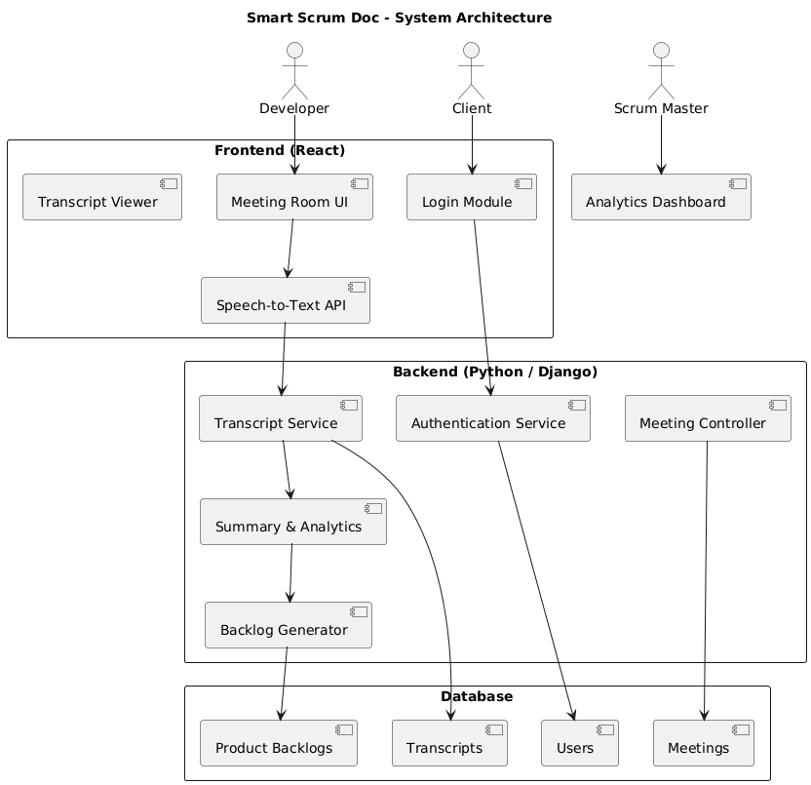
In agile development, the product backlog has a list of tasks and requirements that help guide future work [13]. The system reviews the meeting discussions to find statements about feature requests, improvements, or bug fixes. These statements are turned into entries in the backlog, which help development teams plan their next tasks [14]. To make it easier to use, the system shows the generated information in different formats. Users can view the original meeting transcript, summary notes, listed action items, and backlog entries [15]. The system also has a user authentication module to make sure only authorized people can access the platform. Authentication methods protect the meeting data and control who can view it [16]. Once a user is authenticated, they can start a new meeting or join an existing one through the system's interface. The meeting interface lets participants talk and work together effectively [17]. During the meeting, the system automatically records the audio and prepares it for further analysis. This ensures that no important part of the conversation is left out [18]. After the meeting is over, the system processes the recorded audio to create a transcript and other related results. This automatic processing cuts down on the need for manual note-taking [19]. The system also includes a search feature that lets users find specific information in the meeting transcripts. Search algorithms described in [20] help users quickly find what they need. Another helpful feature is the ability to download meeting documents. Users can export meeting summaries and transcripts for later use [21]. The system’s architecture is built using a modular design where each part does a specific job. Modular designs, as discussed in [22], make the system easier to scale and maintain. Using speech recognition and natural language processing technologies, the system changes unstructured conversations into organized documentation. This combination helps make meeting management more efficient [23]. The system also improves transparency in Scrum teams by clearly documenting discussions, decisions, and task assignments. Clear documentation helps team members keep track of how the project is progressing [24]. Overall, SmartScrumDoc offers a complete solution for automating the documentation of Scrum meetings. By mixing advanced AI technologies with easy-to-use interfaces, the system boosts productivity and ensures that important meeting details are properly recorded and used [25]. To make the system work better, the model uses advanced text processing methods. These help remove extra or repeated information from meeting transcripts. Steps like splitting text into words, removing common words that don’t add much, and breaking sentences into parts help prepare the text for deeper language analysis [26]. The preprocessing stage makes the Natural Language Processing part more efficient. When text is cleaned and organized properly, algorithms can find meaningful patterns in the conversation more easily [27]. This leads to better accuracy when picking out the main points from the meeting transcript. A key part of the system is keeping structured records of past meetings. By storing transcripts, summaries, and backlog items in one place, users can look back on previous discussions and track the progress of projects over time [28]. The storage part of the system ensures all outputs are kept safely for future use. Secure ways of storing data help protect sensitive meeting details while letting the right people access historical records when needed [29]. The system also helps team members work together better by providing clear information on meeting results. When discussions are automatically turned into summaries and task lists, everyone can easily see what they need to do and follow up on their tasks [30]. Another benefit is that the system reduces communication issues within Scrum teams. By clearly writing down decisions, actions, and backlog items, everyone has the same information [31]. Including automatic documentation in Scrum meetings also helps with better project management. Development teams can use the generated backlog items to organize work more effectively and prioritize tasks based on project needs [32]. Moreover, the system supports ongoing improvement in agile environments. By looking at many meeting transcripts over time, the system can help teams spot repeated challenges or commonly discussed problems in their projects [33]. Another advantage is that it helps new team members understand past project discussions. Having access to summarized meeting records lets newcomers quickly learn about previous decisions and what the project needs [34]. Overall, the system shows how AI can be used to
IV. Methodology
A. Architecture
Module 1: Login Module
The Login Module is responsible for providing secure access to the SmartScrumDoc system. It allows different types of users such as clients, developers, and Scrum masters to log into the system using their credentials. This module verifies the identity of users before granting access to the application. It communicates with the backend authentication service to validate user information stored in the database. By ensuring proper authentication, this module prevents unauthorized access to sensitive meeting data. Once a user is successfully authenticated, the system allows them to access the meeting interface and other system features. The module also helps maintain session management during user interaction with the system. Security and privacy of meeting information are maintained through this process. This module acts as the gateway through which users enter the SmartScrumDoc platform.
Module 2: Meeting Room UI
The Meeting Room UI module is the interface where Scrum meetings happen. It lets users join or start meetings through the SmartScrumDoc system. During the meeting, people can talk and discuss project updates, tasks, and decisions. The module records the audio from the conversation. It connects with speech processing tools that help capture the discussion. This interface creates a simple and easy-to-use environment that feels like a real meeting room. The module also helps participants interact smoothly with each other. It serves as the main source for capturing meeting discussions for documentation. By gathering conversation data, the module starts the process of automatically documenting the meeting.

Slide 5
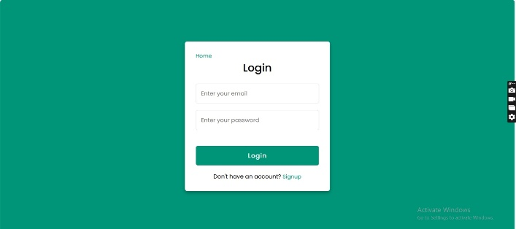
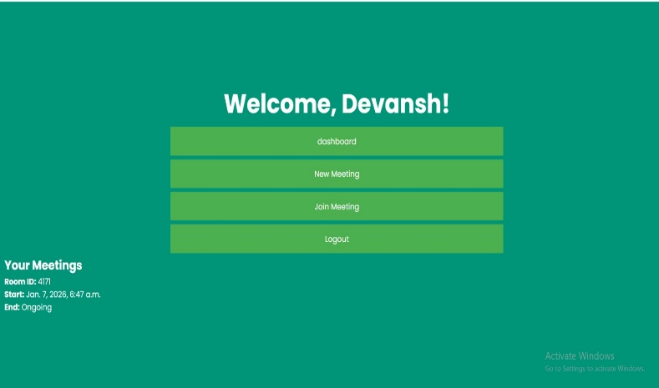
Module 3: Speech-to-Text API
The Speech-to-Text API module turns spoken words from a meeting into text. It uses speech recognition technology to analyze the audio being captured. This module listens to the audio coming from the meeting interface and detects the words that are being spoken. These words are then turned into a written record. This process helps reduce the need for people to write down notes by hand during meetings. The resulting text serves as the main input for additional text analysis. The module makes sure the conversation is accurately turned into text. This text allows the system to carry out natural language processing tasks. By changing speech into text, the module helps automatically record Scrum meetings.
Module 4: Transcript Viewer
The Transcript Viewer module allows users to view the textual record of the meeting discussion. After the speech-to-text process is completed, the generated transcript is displayed through this module. Users can read the full conversation that occurred during the meeting. This helps team members review important discussions and decisions. The module also allows users to quickly navigate through the transcript content. It improves transparency by providing a clear record of meeting interactions. The transcript can be used for reference in future project discussions. It also supports the summarization and backlog generation process. Overall, the module provides easy access to the meeting documentation generated by the system.
Module 5: Authentication Service
The Authentication Service is a part of the backend system that checks if users are who they say they are. It gets login requests from the frontend login module. The service compares the user's entered details with the information stored in the database. If the details match, the user is given access to the system. If not, access is blocked to keep the system secure. This service makes sure only people who are allowed can join meetings. It also keeps track of user sessions and who can do what. Having good authentication helps protect private information and keeps project discussions safe. This module is very important for keeping the whole system secure.
Module 6: Meeting Controller
The Meeting Controller module takes care of the whole meeting process in the system. It connects the front-end meeting interface with the back-end services. This module deals with tasks like creating, joining, and managing meetings. It makes sure meeting data is correctly handled and saved. The Meeting Controller also talks to other parts of the system, like the transcript and analytics modules. It works as a bridge between different parts of the system. By managing all meeting activities, it helps keep everything running smoothly. The module plays a key role in keeping control over meeting sessions. It is a vital part of the system for organizing all meeting-related tasks.
Module 7: Transcript Service
The Transcript Service module is in charge of managing the text that comes from converting speech to written words. It gets the text from the speech recognition module and works with it further. This service saves the transcript information in a database so it can be used later. It also shares the transcript data with other parts of the system, like the analytics and summarization services. The module makes sure the transcript is neatly arranged and formatted. It helps keep a full record of what was discussed in meetings. By saving transcripts, the system lets users look back at meeting talks whenever they need to. The module also helps find the data when it's needed. It's important for keeping track of meeting records.
Module 8: Summary & Analytics Service
The Summary and Analytics Service uses natural language processing to examine meeting transcripts. It finds important sentences, main topics, and decisions made during the meeting. This part of the system handles a lot of text and pulls out useful information. It creates a short summary of what was discussed. This summary allows team members to quickly see the key results of the meeting. The analytics part also
looks for patterns and trends in the conversation. By turning long transcripts into clear summaries, the module boosts productivity. It makes sure important details aren't missed in long talks. This module is vital for turning raw meeting notes into valuable knowledge.
Module 9: Backlog Generator
The Backlog Generator module automatically finds tasks and requirements mentioned during meetings. It looks through the processed meeting notes to spot statements about future work or development tasks. These statements are turned into items in the product backlog. The generated backlog items help Scrum teams organize project needs in a better way. This module supports agile practices by connecting meeting discussions to actual tasks. It also cuts down on the work needed to create backlog entries by hand. The backlog items created can be saved and followed up on later. This helps teams keep their development process organized and structured. Overall, the module links meeting notes with project planning activities.
Module 10: Database
The Database module keeps all the essential data that the SmartScrumDoc system creates. It has organized tables like Users, Meetings, Transcripts, and Product Backlogs. The Users table holds login details and personal information for everyone who uses the system. The Meetings table keeps track of all the meetings that take place. The Transcripts table saves the written notes from meetings, which are made by the speech recognition tool. The Product Backlogs table includes the tasks and items found during meeting reviews. The database helps store and find data quickly. It also helps the system's background services by giving easy access to organized data. Managing the database well makes sure that the system's information is always reliable and stays consistent. This part of the system is where all data is stored long-term.
V. Results
Fig-1 Login module
Fig-2 Dashboard

Slide 6
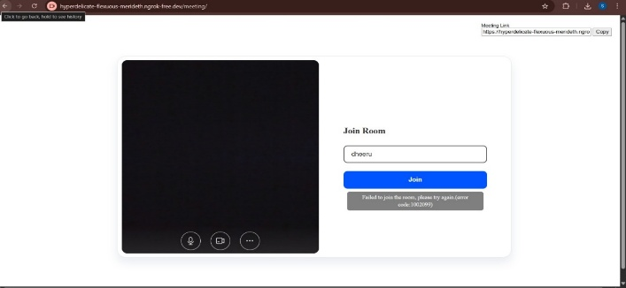
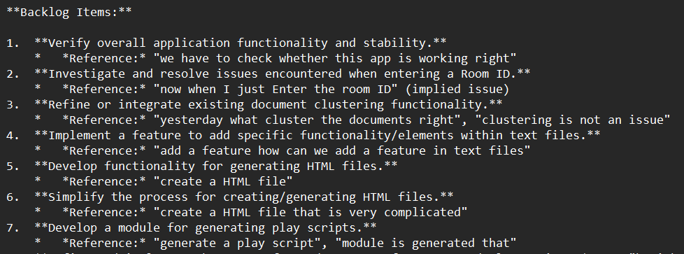
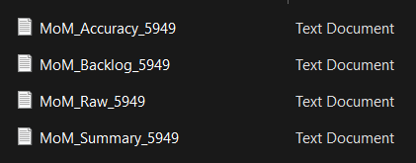
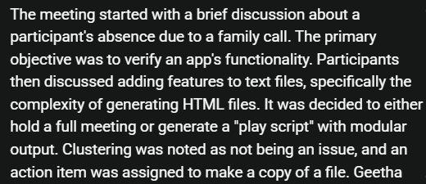
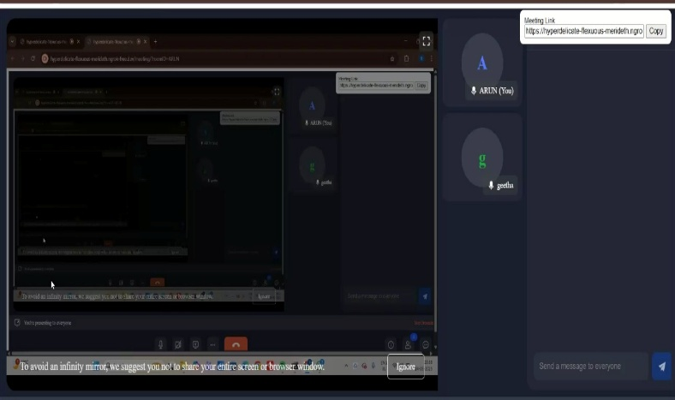
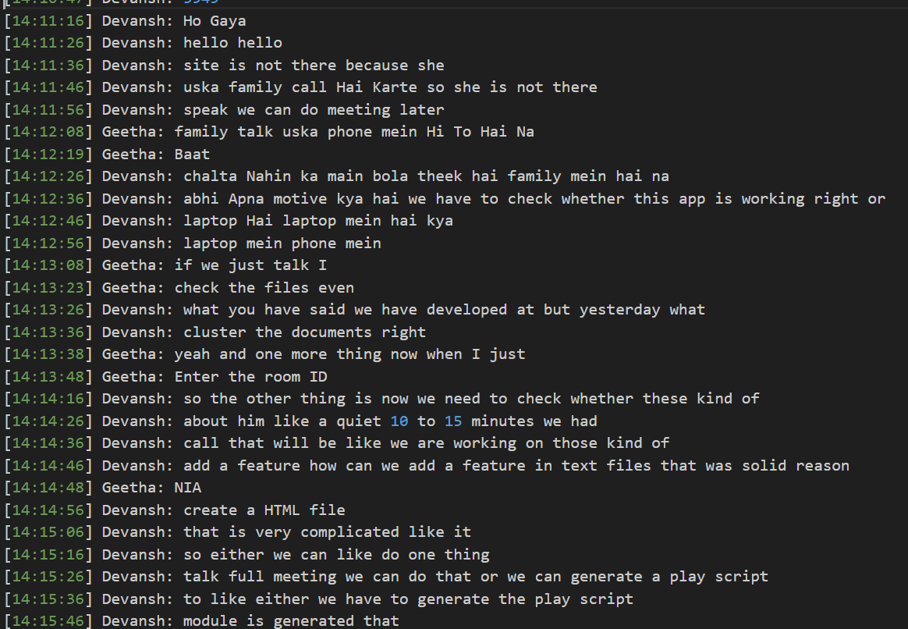
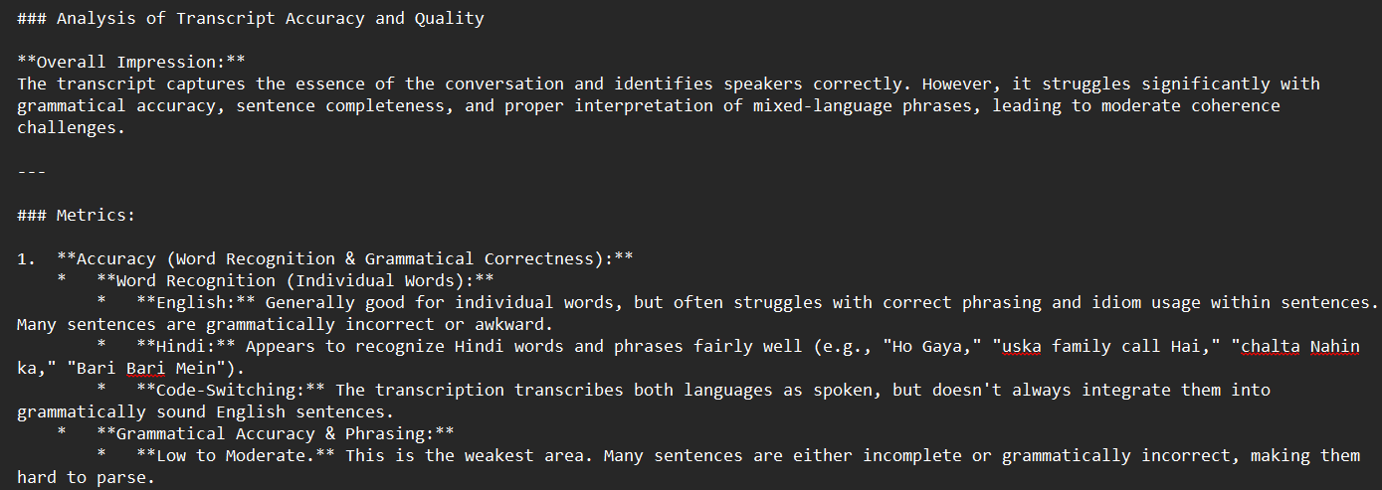
Fig-3 Join Room
Fig-7 Product Backlog list
Fig-8 Summary
Fig-4 Mom files
Fig-9 Meeting Room
Fig-5 Raw Text
VI. Conculsion
The SmartScrumDoc system was created to tackle the difficulties of documenting Scrum meetings in software development projects. Typically, keeping track of meeting notes by hand is time-consuming and can lead to mistakes or left-out details. By using automation in the documentation process, the system seeks to make things more efficient and accurate. It captures conversations from meetings and turns them into organized text. This helps reduce the workload on team members who would otherwise have to write down meeting minutes manually. The automatic documentation ensures that important points from the meetings are kept safe. It also makes the meeting records more reliable for Scrum teams.
Fig-6 Accuracy file

Slide 7
The SmartScrumDoc system was created to tackle the difficulties of documenting Scrum meetings in software development projects. Typically, keeping track of meeting notes by hand is time-consuming and can lead to mistakes or left-out details. By using automation in the documentation process, the system seeks to make things more efficient and accurate. It captures conversations from meetings and turns them into organized text. This helps reduce the workload on team members who would otherwise have to write down meeting minutes manually. The automatic documentation ensures that important points from the meetings are kept safe. It also makes the meeting records more reliable for Scrum teams. A key part of the system is the use of speech recognition technology. This technology turns spoken words into written text with very little help from people. This allows the system to handle meeting discussions quickly and effectively. The written transcript then serves as the base for further work. By removing the need for manual transcription, the system saves time and effort. It also ensures that discussions are neatly formatted for easy use. The system also uses Natural Language Processing to make the most of the text it generates. These advanced techniques help the system find important points, action steps, and decisions from the meeting discussions. This ability to analyze large volumes of text speeds up the system's effectiveness. It also helps turn raw conversation data into structured and useful information. As a result, meeting results are easier to understand and manage. The SmartScrumDoc system also offers automated summarization of meetings. Instead of going through long transcripts, users can get quick summaries created by the system. These summaries highlight the most important parts of the meeting. This helps team members save time and focus on critical decisions. The summarization process boosts productivity within Scrum teams. It ensures that key information is clearly communicated. Another major benefit of the system is the automatic creation of product backlog items. Scrum meetings often include talks about tasks, features, and future improvements that need to be part of the project. Manually spotting these tasks can be slow. The SmartScrumDoc system automatically picks up on such discussions and turns them into backlog entries. This helps teams keep their list of development tasks organized. It also links meeting discussions to the overall project plans. The system’s architecture is designed to work smoothly between different parts like the user interface, the backend processing, and the data storage. Each part has a specific job in handling meeting data. The user interface lets people interact with the system in a simple and easy way. The backend handles speech recognition, text processing, and analysis. The database keeps transcripts, summaries, and backlog items for later use. This well-organized setup helps the system be scalable and easy to maintain. The system also helps team members work better together. By making meeting records and summaries available, all team members can stay updated on discussions, even if they couldn’t attend the meeting. This ensures nothing important gets missed. The system supports better communication within development teams. Better communication ultimately leads to improved project management. Another good idea is to connect SmartScrumDoc with other project management tools. When the system is linked to task management platforms, backlog items can be moved automatically into the development process. This helps make the connection between what's discussed in meetings and the actual work being done. This kind of integration would really help make agile project management better. Even though the system has some good features, there are certain issues that need to be fixed in the future. Adding real-time analytics can also give useful insights during meetings. These improvements will make the system smarter and more efficient. Keeping on improving AI models will help the system get even better over time.In short, the SmartScrumDoc system shows how AI can be used to make meeting notes easier in agile settings. By using speech recognition and natural language processing, the system turns meeting talks into written notes, summaries, and backlog items. This makes teamwork more efficient, clear, and collaborative. The system offers a real solution for keeping track of Scrum meetings.
VII. References
D. Minkov, “Transforming meetings and docs with AI speech-to-text,” Medium,Sep.5,2023.
T. van Can and F. Dalpiaz, “Locating requirements in backlog items: Content analysis and experiments with large language models,” Information and Software Technology, vol. 179, p. 107644, Mar. 2025.
R. E. Stanly, “Building an AI-powered Microsoft Teams meeting summarizer (Transformers + NER + Azure Speech-to-Text),” Medium, Jan. 17, 2026.
A. Vaddi and K. Swapna, “Automatic Meeting Minutes Generation,” International Journal for Research in Applied Science & Engineering Technology (IJRASET), vol. 11, no. 4, pp. 1–8, 2023.
R. Khan and M. S. Khan, “AI-Powered Virtual Meeting Summarization System,” SSRN, Jul. 2025.
A. Pandya and N. Gawande, “Automatic Generation of Minutes of Meetings,” Int. J. Sci. Res. Sci. Eng. Technol., vol. 9, no. 2, pp. 93–99,Mar.–Apr.2022.
H. B. Chandaka, D. R. Kandimalla, V. Turaka, and N. Shivani, “Voice Meeting Summarization,” Int. J. Curr. Sci. (IJCSPUB), vol. 13, no. 2, pp. 616–623, May 2023.
S. Rezazadegan, S. Berkovsky, J. C. Quiroz, A. B. Kocaballi, Y. Wang, L. Laranjo, and E. Coiera, “Automatic Speech Summarisation: A Scoping Review,” arXiv:2008.11897, Aug. 2020.
S. Furui, T. Kikuchi, Y. Shinnaka, and C. Hori, “Speech-to-text and speech-to-speech summarization of spontaneous speech,” IEEE Trans. Speech Audio Process., vol. 12, no. 4, pp. 401–408, Jul. 2004.
K. Shinde, L. Besacier, O. Bojar, T. Thonet, and T. Ghosal, “Findings of the Third Automatic Minuting (AutoMin) Challenge,” arXiv:2509.13814, Sep. 2025.
J. Carletta, S. Ashby, S. Bourban, M. Guillemot, M. Kronenthal, G. Lathoud, and M. Lincoln, “The AMI Meeting Corpus: A Pre-announcement,” Machine Learning for Multimodal Interaction, pp. 28–39, 2005.
G. Murray, S. Renals, J. Carletta, and J. Moore, “Incorporating speaker and discourse features into speech summarization,” Proceedings of the Human Language Technology Conference, pp. 367–374, 2005.
L. Laban, S. Berkovsky, and E. Coiera, “Meeting summarization: A review of approaches and challenges,” ACM Computing Surveys, vol. 55, no. 3, pp. 1–38, 2023.
H. Christensen, Y. Gotoh, and S. Renals, “Automatic summarization of meeting speech,” IEEE Workshop on Automatic Speech Recognition and Understanding, pp. 133–138, 2004.
M. Janin, D. Baron, J. Edwards, and D. Ellis, “The ICSI Meeting Corpus,” IEEE International Conference on Acoustics, Speech, and Signal Processing, pp. 364–367, 2003.
A. Gupta and R. Kumar, “AI-based meeting transcription and summarization system,” International Journal of Computer Applications, vol. 184, no. 22, pp. 15–20, 2022.
P. Liu and W. Chen, “Automatic meeting summarization using natural language processing techniques,” IEEE International Conference on Artificial Intelligence and Knowledge Engineering, pp. 45–50, 2021.
S. Mehta and P. Shah, “Speech recognition and summarization system for business meetings,” International Journal of Advanced Computer Science and Applications, vol. 12, no. 7, pp. 325–332, 2021.
R. Patel and K. Sharma, “Automated extraction of action items from meeting transcripts using NLP,” Journal of Information Processing Systems, vol. 19, no. 1, pp. 44–58, 2023.
A. R. Pathak and S. Kulkarni, “AI-assisted documentation system for collaborative meetings,” Proceedings of the International Conference on Intelligent Systems and Applications, pp. 112–118, 2024.

